Slide 1




Monitoring For Recent Tectonic Activity On Mars
Brendan S. Bogar | Chris H. Okubo
University of Arizona

Slide 2

Outline and Acknowledgements
Outline
Statement of Problem
Objectives
Methods/Analysis Technique
Results
Interpretation of Results
Interpretations cont./Future Applications
Notes:
High-Resolution Imaging Science Experiment (HiRISE) images of the Martian surface will be examined for tectonic features that appear fresh and potentially active. These potentially-active features will be cataloged and targeted for reimaging by the HiRISE camera to evaluate for recent activity.

Slide 3
Statement of Problem
Satellite imaging not fully analyzed for tectonic activity over time
Difference in overlapping imaging across multiple years is not investigated for tectonic activity, usually for surface changes only
Image analysis is difficult to accomplish on individual basis
933 stereo pairs collected during HiRISE’s first year in operations not updated or organized according to tectonic activity

Slide 4
Objectives
Examining the oldest and highest-resolution HiRISE stereo images of Mars beginning with images taken August 7th, 2007
A total of 933 stereo pairs collected during HiRISE’s first Mars year in operation to be prioritized and compared along season and time
New images will be visually compared with the old images to evaluate for any surface changes that may indicate tectonic activity
New techniques are to be investigated to enhance tectonic analysis work-flow
Notes:
Priority will be given to the examining the oldest and highest-resolution HiRISE stereo images of Mars. A total of 933 stereo pairs were collected during HiRISE’s first Mars year in operations – these are the highest-priority images to be examined because these have the longest temporal baseline of all HiRISE stereo images. To gain a wide-ranging sample of potentially-active tectonic features, all frost-free and haze-free stereo images across the entire planet will be examined. All tectonic features will be investigated, including faults, joints, and drainage pits.

Slide 5
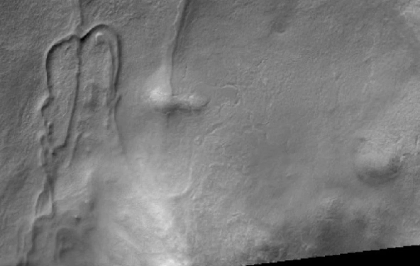
ESP_053753_2505_RED
vs
PSP_009803_2505_RED
Notes:
PSP taken on 2008-Sep-05-249 ESP taken on 2018-Jan-05-005
Taken 9 years different
153368 Flow lobes in northern plains crater Tectonic Processes 25290 Flow lobes in northern plains crater Glacial/Periglacial Processes
High priority to Jim Garvin; see Garvin et al., 2006, Meteoritics and Planetary Sci. Possible drop moraines. Previous image 7153_2505 was frosty and not in the ideal location. Color/Stereo/CRISM Justification: model flow

Slide 6
Objectives (cont.)
Incidental Solar Longitudes (days on Mars)
Within accomplishable season of internship
Delta Days less than 100
Priority of tectonic investigation to include faults, joints, and drainage pits
Promising tectonic attributes for selected landscapes to be re-imaged

Slide 7
Methodology Used
Solar longitudes (Ls) and incidental seasonal changes to decrease potential candidates
Dates between stereo images taken to increase image quality and difference
Landscapes noted with larger chance of tectonic activity placed with imaging priority
Re-imaging of areas of Mars must be within similar seasons for better comparison of landscapes
Notes:
The HiRISE observation IDs and geographic locations of potentially-active tectonic features will be recorded in a spreadsheet. Then these features will be targeted for reimaging by HiRISE by generating new image suggestions in HiWish, the web-based HiRISE image suggestion tool. If any features are reimaged by HiRISE before the end of the Space Grant project, these new images will be visually compared with the old images to evaluate for any surface changes that may indicate tectonic activity. Any evidence of possible evidence of tectonic activity will be followed up with stereo imaging and more detailed analysis.

Slide 8
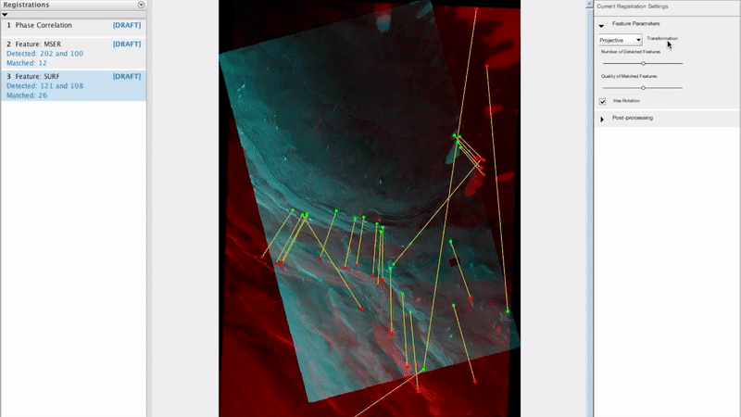
Methodology Used (cont.)
ESP_053334_2650_RED
vs
PSP_009279_2650_RED
Notes:
ESP_053334_2650_RED taken on 2017-Dec-06-340
PSP_009279_2650_RED taken on 2008-Jul-24-206
Taken 10 years apart

Slide 9
Results
Total of seven sets of stereo images re-imaged for tectonic analysis
Use of Matlab machine learning for image registration and comparison aided in identifying potential differences
Potential differences across images were noted and are to be peer-reviewed for accuracy before confirmation is made
Notes:
Baseline deliverables of this project will be the spreadsheet of potentially-active tectonic features and image targets entered into HiWish. Enhanced deliverables are comparisons between new and old images of potentially-active features.

Slide 10
Potential Opportunities
Using Machine learning along with geo-physicist knowledge and direction to produce tectonic imaging references
Better future analysis speed for higher image resolution and image quantity
Decreasing the learning curve towards in depth, successful tectonic analysis
Notes:
Incumbent will examine HiRISE images, document potentially-active tectonic features, enter new image suggestions in HiWish, and visually compare new and old images.

Slide 11
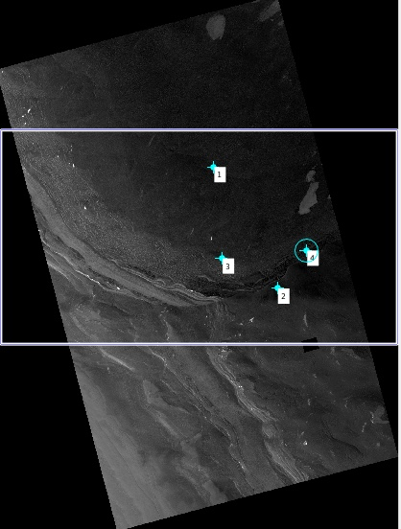
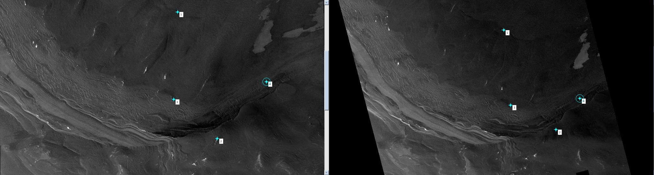
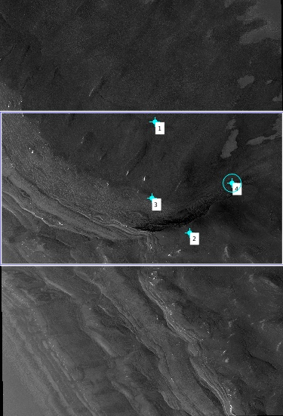
ESP_053334_2650_RED
PSP_009279_2650_RED

Slide 12
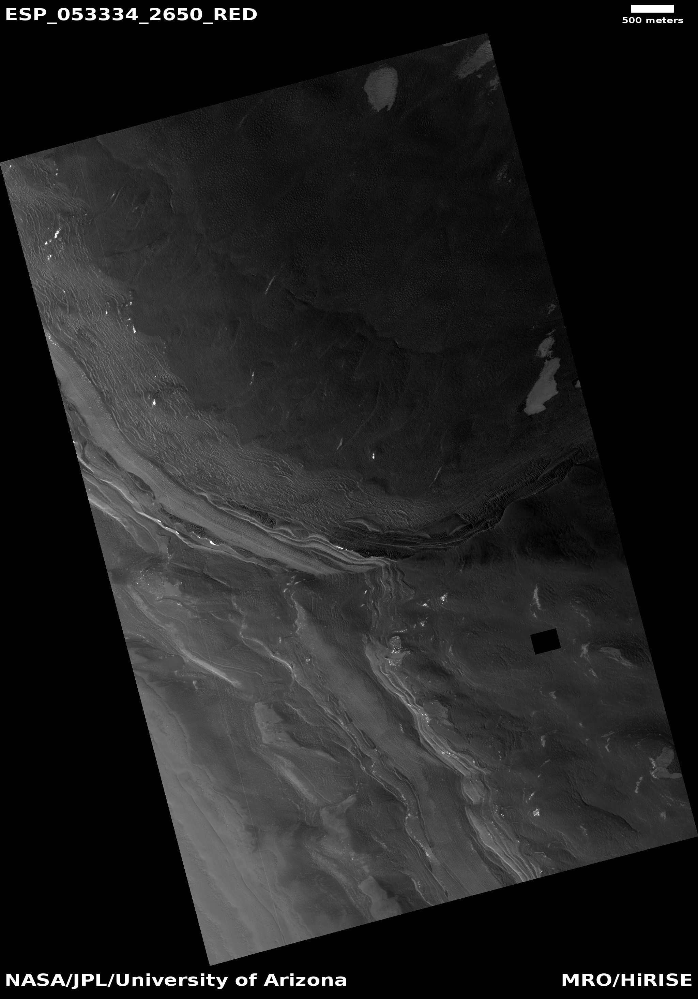
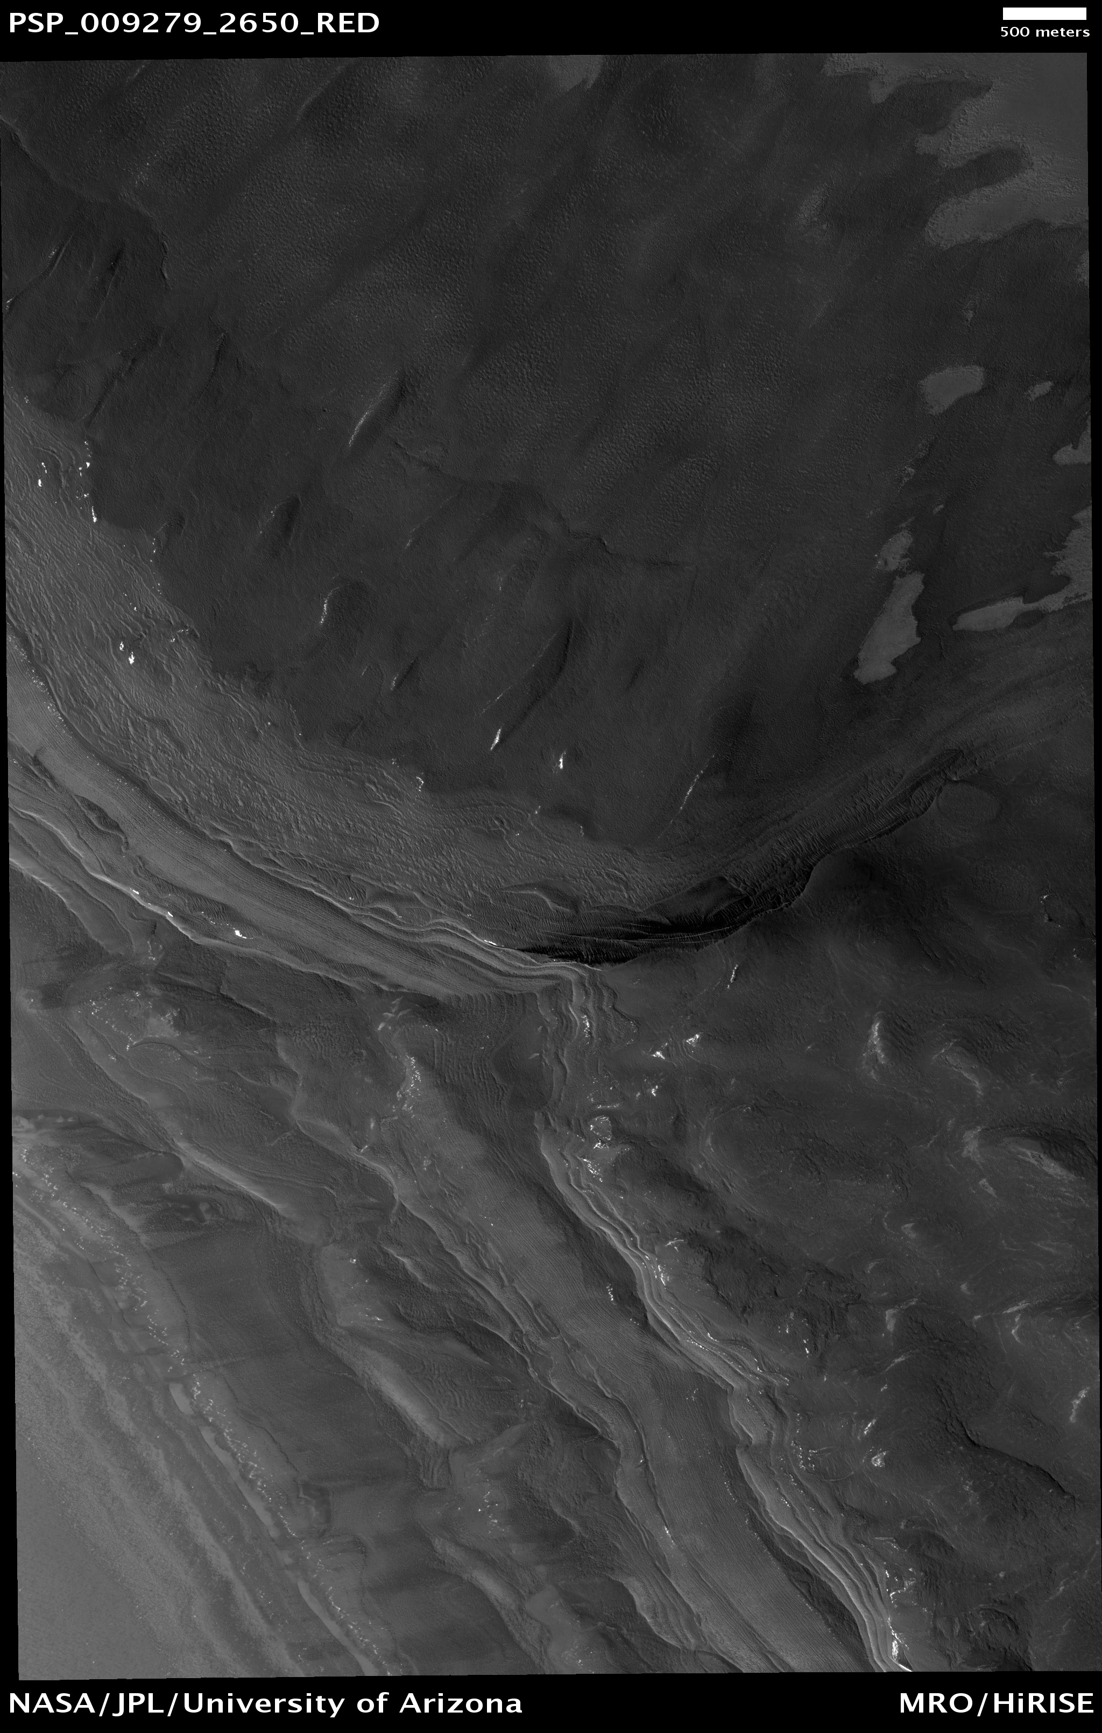

Slide 13
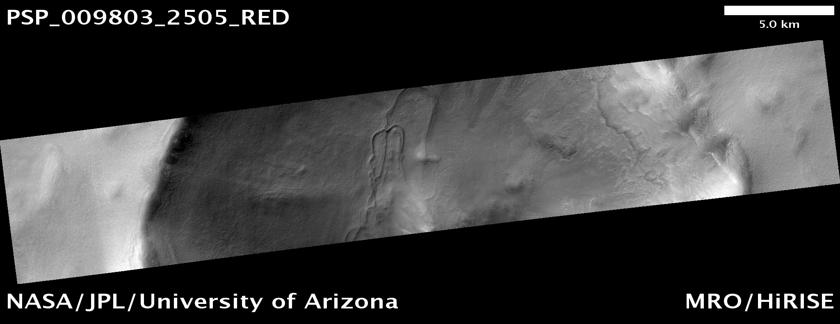

Slide 14
